Slide 1
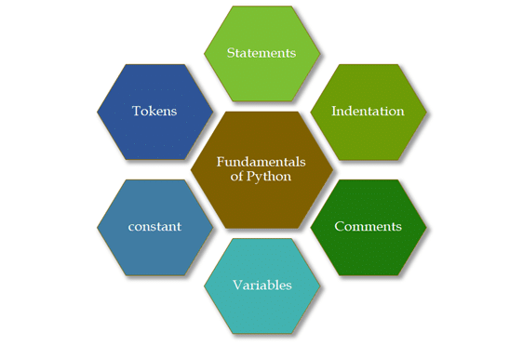
Python Fundamentals:
Fundamentals of Python consists of discussion of basic building blocks of Python programming language.Here, “Fundamentals of Python” is divided into the following categories.

Slide 2
Statements
Python statements are nothing but logical instructions that interpreter can read and execute. It can be both single and multiline.
There are two categories of statements in Python:
Expression Statements
Assignment Statements
Expression Statement:
With the help of expressions, we perform operations like addition, subtraction, concentration etc.
In other words, it is a statement that returns a value.
Using simple arithmetic expression:
(1+5) * 3
18
Using a function in an expression:
pow (3,2)
9

Slide 3
Assignment Statements:
With the help of assignment statements, we create new variables, assign values and also change values.
Structure of an assignment statement syntax:
#LHS <=> RHS
variable = expression
test= “Hello World”
id(test)
test1= 7 * 2 / 10
type(test1)
output:
float
Python allocates same memory location for the two cases mentioned below:
If the strings with less than 20 characters that don’t have white spaces and
Integers ranging between (-5 to +255).
This concept used by Python to save memory is also called Interning.

Slide 4
Python Multiline Statements
Python does provide a way to split a statement into a multiline statement or to join multiple statements into one logical line. This can be helpful to increase the readability of the statement.
Explicit Line Joining
In explicit line joining, we use a backward slash to split a statement into a multiline statement.
print ("this\
is a python coding example")
Implicit Line Joining
Statements that reside inside [], {}, or () parentheses can be broken down into two or more physical lines without using a back slash.
months = [' January', 'February',
'March', 'April']

Slide 5
Multiple Statements on a Single Line
In Python, it is possible to club multiple statements in the same line using a semi-colon; however, most programmers do not consider this to be a good practice as it reduces the readability of the code.
Example:
a=10; b=30;
print(a); print(b);

Slide 6
Indentation
Indentation is defined as the no. of white spaces that are used to define a specific area or block or region and this is a convention in python which every programmer should follow.
However, some languages (such as Python and Occam) use indentation to determine the structure instead of using braces or keywords; this is termed the off-side rule. In such languages, indentation is meaningful to the compiler or interpreter; it is more than only a clarity or style issue.
For example, if we run the following code, we will get an error of ‘expected indentation’:
a=1
if a>0 :
print("There is no indentation in this statement")

Slide 7
Comments
Comments in python or any programming language are assumed to be non-readable parts of any program by the compiler/interpreter.
Comments are used to explain any code, make the code more readable, and to prevent execution when testing code.
#This is a comment
print("Hello, World!")
Multi Line Comments
Python does not really have a syntax for multi line comments.To add a multiline comment you could insert a # for each line:
#This is a comment written in
#more than just one line
print("Hello, World!")
Or, not quite as intended, you can use a multiline string.Since Python will ignore string literals that are not assigned to a variable, you can add a multiline string (triple quotes) in your code, and place your comment inside it:
'''This is a comment
written in
more than just one line'''
print("Hello, World!")

Slide 8
Constants
Constant is a type of variable that holds values, whose value cannot be changed. In reality we rarely use constants in python.
Assigning a value to a constant in Python.
PI = 3.14
GRAVITY = 9.8

Slide 9
Token
Tokens are the smallest unit of the program. There are following tokens in Python:
Reserved words or Keywords
Identifiers
Literals
Operators

Slide 10
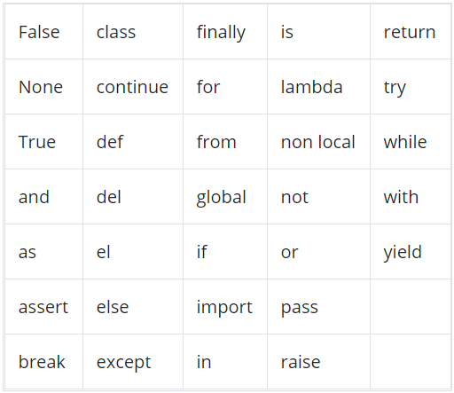
Reserved Words
Reserved words are nothing but a set of special words, which are reserved by Python and have specific meanings. Remember that we are not allowed to use keywords as Variables in Python.
Reserved words in Python are case sensitive.

Slide 11
Literals
The other built-in objects in python are Literals. Literals can be defined as data that is given in a variable or constant. Python has following literals:
String Literals:
A string literal is a sequence of characters surrounded by quotes. We can use both single, double or triple quotes for a string. And, a character literal is a single character surrounded by single or double quotes.
Numeric Literals:
Numeric Literals are immutable (unchangeable). Numeric literals can belong to 3 different numerical types Integer, Float, and Complex.
Boolean Literals:
A Boolean literal can have any of the two values: True or False.
Collection literals:
There are four different literal collections List literals, Tuple literals, Dict literals, and Set literals.
Special literals:
Python contains one special literal i.e. None. We use it to specify to that field that is not created.

